Slide 1
W4111 – Introduction to Databases Lecture 12: Data Engineering and Insight
W4111-2024F-12-Data-Engineering-Insight © 2024, Donald F. Ferguson

Slide 2
Contents

Slide 3
Contents
Finalizing the semester
Final exam
Homework 4 and project
Recitation/OHs schedule
A brief overview of scalability and availability
”Big Data:”
Big Data
Data Engineering
A little bit of Data Analytics
Some examples from HWs 3b and 4b
Conclusions

Slide 4
Finalizing the Semester

Slide 5
Contents
Final exam
13-DEC from 9:00 AM to 12:00 AM in class lecture room.
If you require accommodation or modification
You must complete and submit the form specified in the Ed post.
We will contact you with instructions.
We have much less flexibility than the midterm because we have grade submission deadlines.
The structure, approach, format and rules are the same as for the midterm
We will provide a “cheat sheet” that you must print in advance.
You may optionally also have your own one-page, double-sided cheat sheet.
Homework 4
Is written questions and we will release this weekend.
Due 15-DEC at 11:59 PM; You may not use late days.
The material is a subset of the material for the final and will help you study.
Project
For various reasons, we ran out of time and will not have a project this semester.
I will publish a project over the winter break. If you want me to write a letter of recommendation in the future, you must complete and submit the project.

Slide 6
OHs/Recitation
TA OHs
The TAs are updating their OH schedule and will publish.
I am encouraging them to hold OHs, but they are also students.
Professor OHs and recitations
Unlike most semester, I am on a business trip and in meetings all week.
I will try to hold several OH/recitation sections but am not sure of the number and when I will hold them.
My schedule is very dynamic and there may be last minute announcements or changes. I will give as much notice as I can.
I will be as active and responsive on Ed as I can.

Slide 7
Scalability and Availability

Slide 8
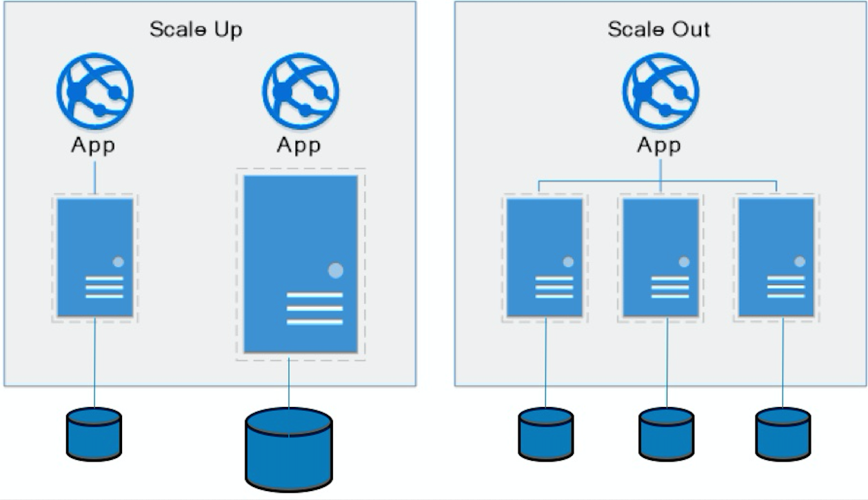
Approaches to Scalability
Scalability is the property of a system to handle a growing amount of work by adding resources to the system.
Replace system with a bigger machine, e.g. more memory, CPU, ... ...
Scale-up:
Less incremental.
More disruptive.
More expensive for extremely large systems.
Does not improve availability.
Scale-out:
Incremental cost.
Data replication enables availability.
Does not work well for functions like JOIN, referential integrity, ... ...
Add another system.

Slide 9
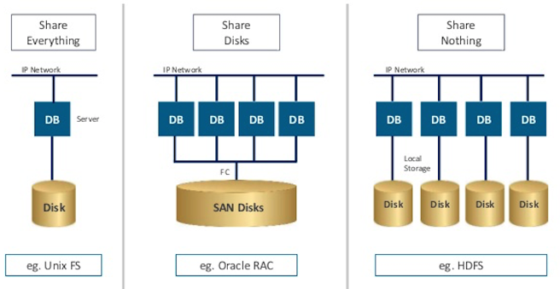
Disk Architecture for Scale-Out
Share disks:
Is basically scale-up for data/disks. You can use NAS, SAN and RAID.
Isolation/Integrity requires distributed locking to control access from multiple database servers.
Share nothing:
Is basically scale-out for disks.
Data is partitioned into shards based on a function f() applied to a key.
Can improve availability, at the code consistency, with data replication.
There is a router that sends requests to the proper shard based on the function.

Slide 10
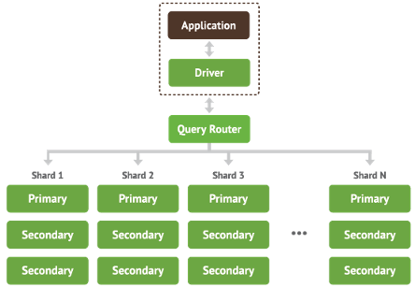
Shared Nothing, Scale-Out
MongoDB Sharding
DynamoDB Partitioning

Slide 11
Big Data
Data Engineering
Data Analysis

Slide 12
Big Data

Slide 13
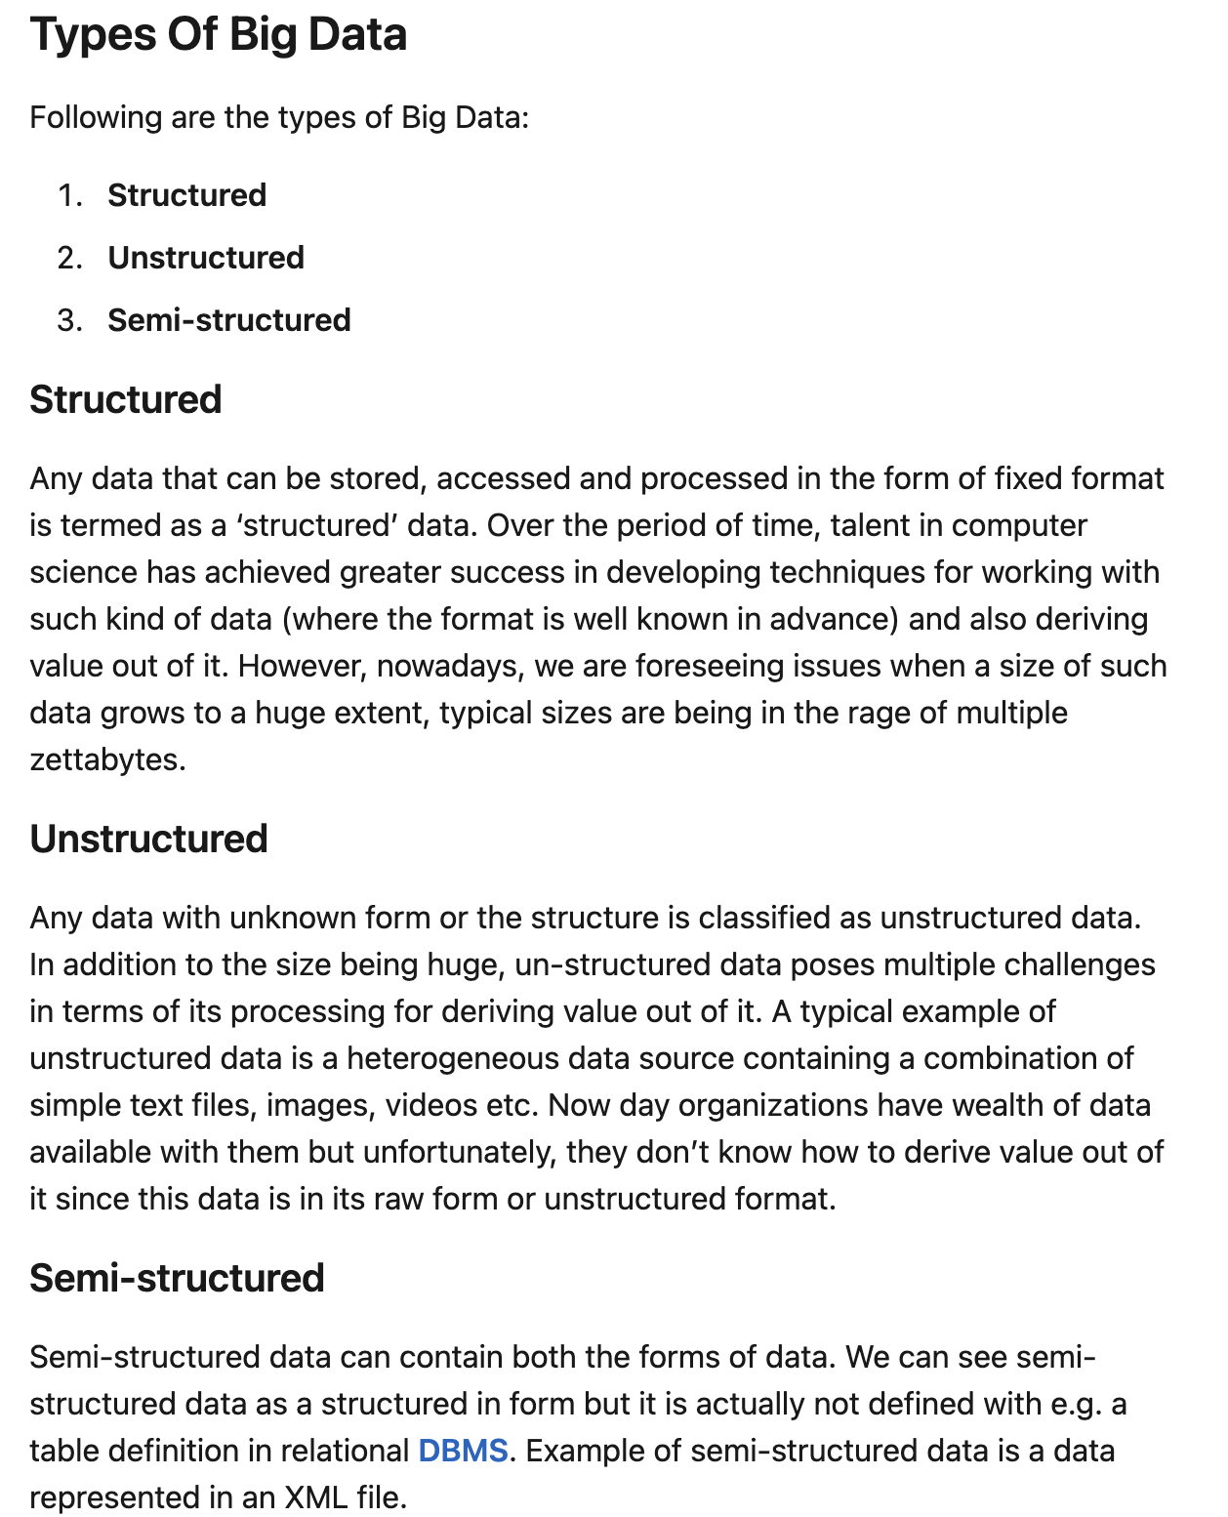
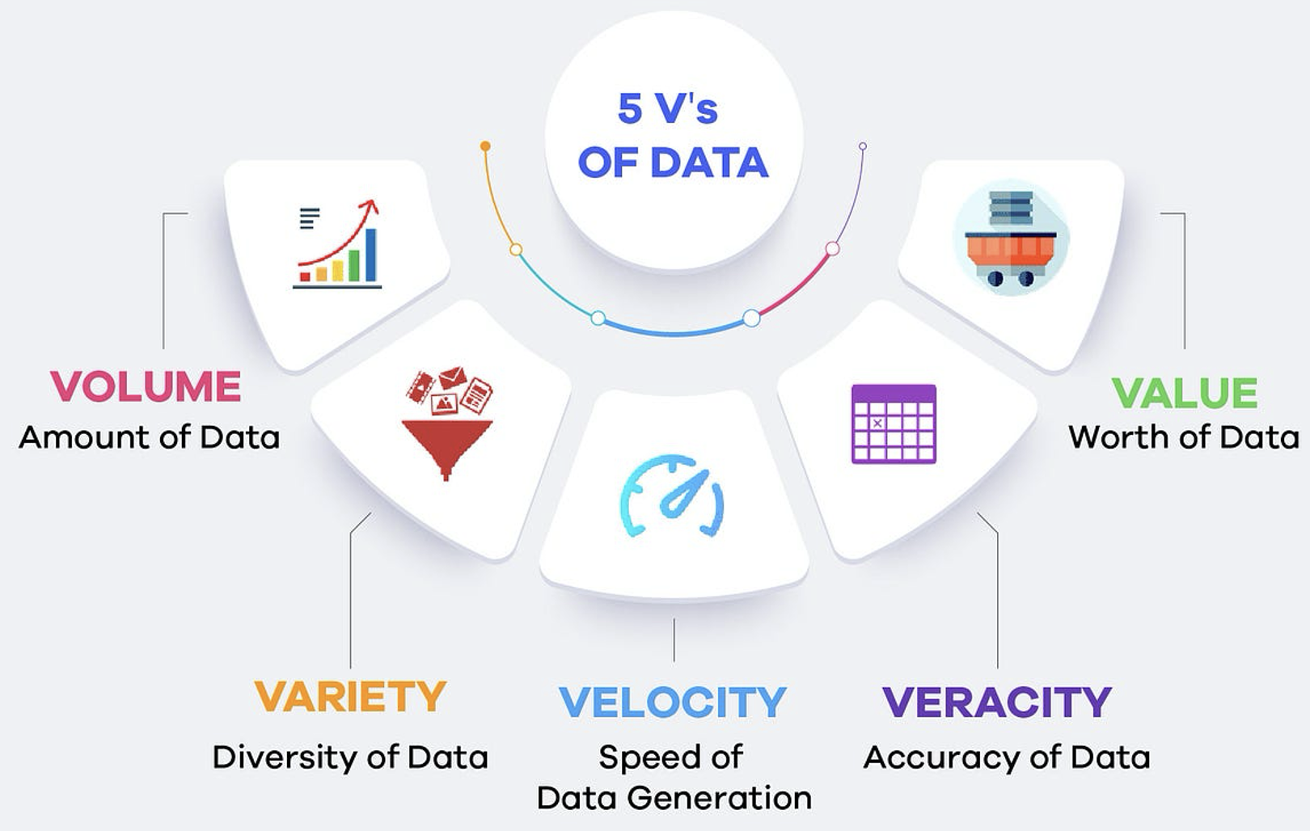
5 V’s of Big Data
https://www.linkedin.com/pulse/big-data-management-revolutio-parichehr-esmailian/
https://medium.com/@get_excelsior/big-data-explained-the-5v-s-of-data-ae80cbe8ded1

Slide 14
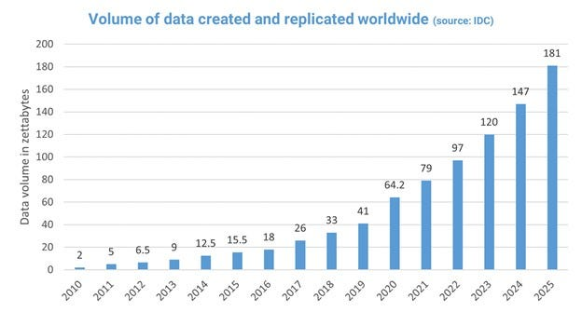
Growth in Big Data
https://medium.com/@mwaliph/exponential-growth-of-data-2f53df89124

Slide 15
Overview
Data analytics: the processing of data to infer patterns, correlations, or models for prediction
Primarily used to make business decisions
Per individual customer
E.g., what product to suggest for purchase
Across all customers
E.g., what products to manufacture/stock, in what quantity
Critical for businesses today

Slide 16
Overview (Cont.)
Common steps in data analytics
Gather data from multiple sources into one location
Data warehouses also integrated data into common schema
Data often needs to be extracted from source formats, transformed to common schema, and loaded into the data warehouse
Can be done as ETL (extract-transform-load), or ELT (extract-load-transform)
Generate aggregates and reports summarizing data
Dashboards showing graphical charts/reports
Online analytical processing (OLAP) systems allow interactive querying
Statistical analysis using tools such as R/SAS/SPSS
Including extensions for parallel processing of big data
Build predictive models and use the models for decision making

Slide 17
Overview (Cont.)
Predictive models are widely used today
E.g., use customer profile features (e.g. income, age, gender, education, employment) and past history of a customer to predict likelihood of default on loan
and use prediction to make loan decision
E.g., use past history of sales (by season) to predict future sales
And use it to decide what/how much to produce/stock
And to target customers
Other examples of business decisions:
What items to stock?
What insurance premium to change?
To whom to send advertisements?

Slide 18
Overview (Cont.)
Machine learning techniques are key to finding patterns in data and making predictions
Data mining extends techniques developed by machine-learning communities to run them on very large datasets
The term business intelligence (BI) is synonym for data analytics
The term decision support focuses on reporting and aggregation

Slide 19
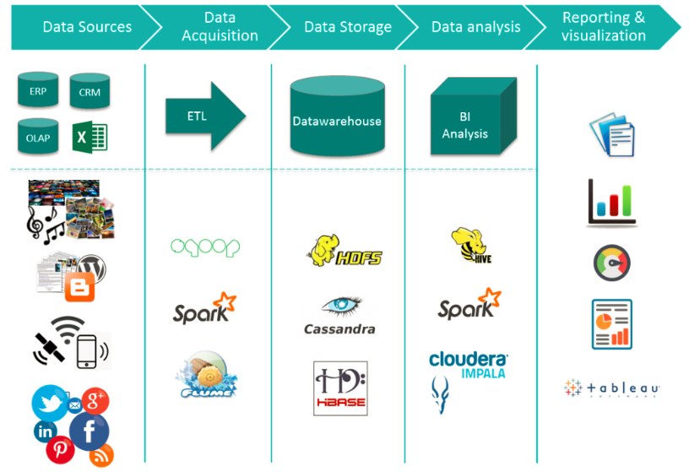
Big Data Ecosystem/Platform
https://medium.com/@jain6968/big-data-ecosystem-b0e4c923d7aa

Slide 20
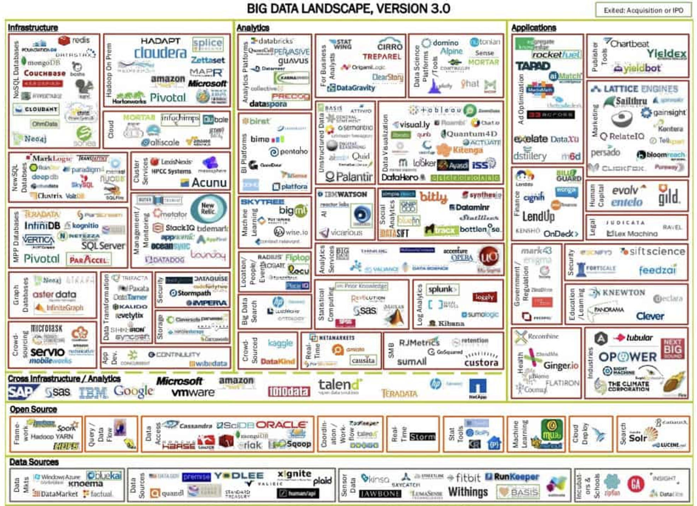
Big Data Ecosystem/Platform
https://dataconomy.com/2014/06/03/understanding-big-data-ecosystem/

Slide 21
Data Engineering

Slide 22
Data Warehouse and Data Lake

Slide 23
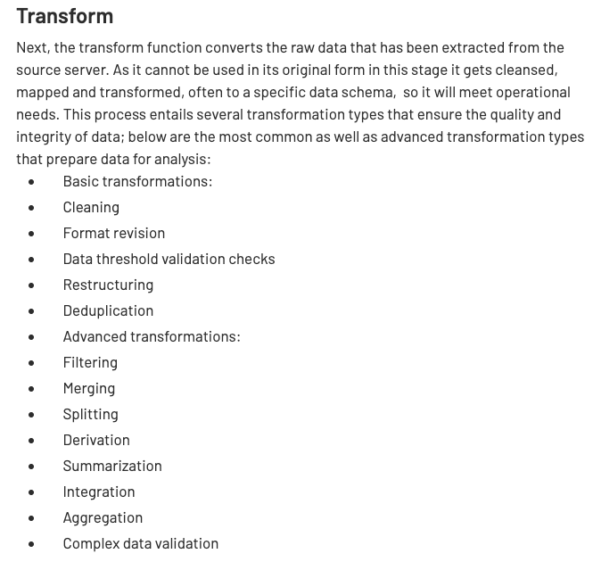
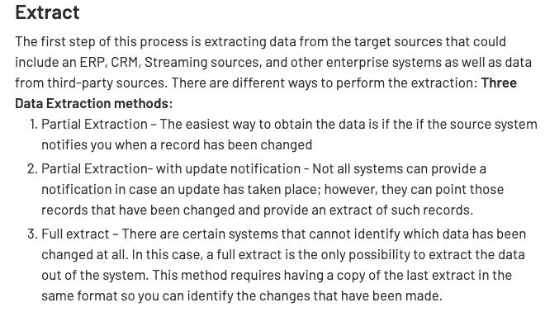
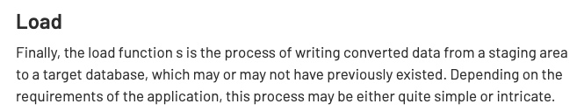
ETL Concepts
https://databricks.com/glossary/extract-transform-load

Slide 24
MapReduce
MapReduce is a data flow program with relatively simple operators on the data set.
op1
op2
op3
With each operator implemented in parallel on multiple nodes for performance.
What we want more complex “operators?”

Slide 25
The Value of Blocks
The “normal” file system abstraction is a stream.
Consider a very large CSV file:
We can read using the normal file system functions and APIs,
But we have no idea where records start/end, and
Which records on on which blocks.
➔
Parallel processing of data in a file is very hard using the stream model.
Databases, big data tools, etc. surface concepts of record size, block I/Os, mapping of and organization of records to blocks, block location, … … ➔
Can exploit module processors to parallel process large datasets.
Organize the data to optimize processing, file I/Os, etc.

Slide 26
Parallel Processing of MapReduce Job
User
Program
copy
copy
copy
Master
assign
map
assign
reduce
Part 1
Map 1
Reduce 1
File 1
Part 2
Part 3
Map 2
Reduce 1
write
File 2
Part 4
local
write
Part n
read
Map n
Reduce m
File m
Remote
Read, Sort
Input file
partitions
Intermediate
files
Output files

Slide 27
Map Reduce vs. Databases
Map Reduce widely used for parallel processing
Google, Yahoo, and 100’s of other companies
Example uses: compute PageRank, build keyword indices, do data analysis of web click logs, ….
Allows procedural code in map and reduce functions
Allows data of any type
Many real-world uses of MapReduce cannot be expressed in SQL
But many computations are much easier to express in SQL
Map Reduce is cumbersome for writing simple queries

Slide 28
Map Reduce vs. Databases (Cont.)
Relational operations (select, project, join, aggregation, etc.) can be expressed using Map Reduce
SQL queries can be translated into Map Reduce infrastructure for execution
Apache Hive SQL, Apache Pig Latin, Microsoft SCOPE
Current generation execution engines support not only Map Reduce, but also other algebraic operations such as joins, aggregation, etc. natively.

Slide 29
Algebraic Operations
Current generation execution engines
Natively support algebraic operations such as joins, aggregation, etc. natively.
Allow users to create their own algebraic operators
Support trees of algebraic operators that can be executed on multiple nodes in parallel
E.g. Apache Tez, Spark
Tex provides low level API; Hive on Tez compiles SQL to Tez
Spark provides more user-friendly API
In the relational model,
The are relations.
A fixed set of operators that produce relations from relations (closed).
Are declarative languages and compute the execution graph/plan.
The Spark/... ... engines:
Enable programmers to develop and add new operators.
Operators convert reliable distributed datasets/data frames to new RDDs/data frames.
Data engineer explicitly defines the execution graph (data flow).

Slide 30
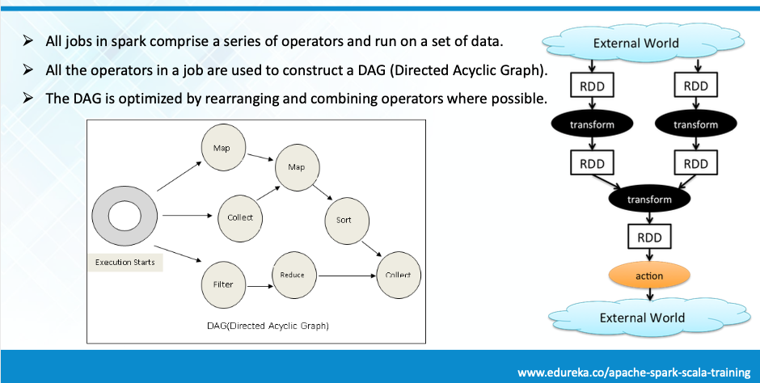
Spark

Slide 31
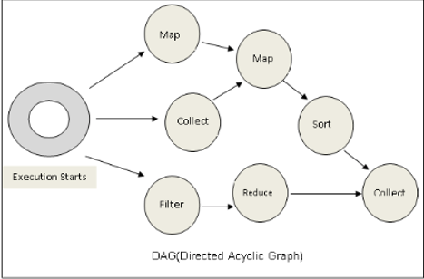
Spark
Conceptually similar to query evaluation graph, but ...
You explicitly define the graph.
You can develop your own operators.

Slide 32
Algebraic Operations in Spark
Resilient Distributed Dataset (RDD) abstraction
Collection of records that can be stored across multiple machines
RDDs can be created by applying algebraic operations on other RDDs
RDDs can be lazily computed when needed
Spark programs can be written in Java/Scala/R
Our examples are in Java
Spark makes use of Java 8 Lambda expressions; the code
s - > Arrays.asList(s.split(" ")).iterator()
defines unnamed function that takes argument s and executes the expression Arrays.asList(s.split(" ")).iterator() on the argument
Lambda functions are particularly convenient as arguments to map, reduce and other functions

Slide 33
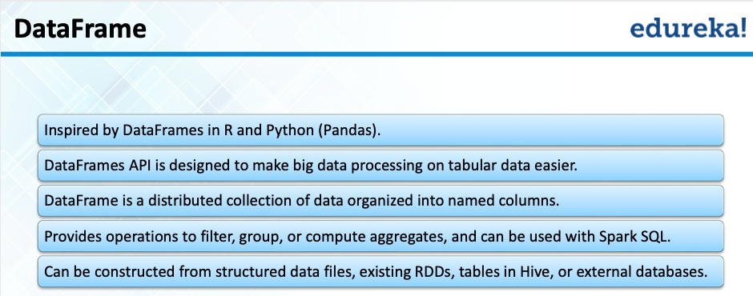
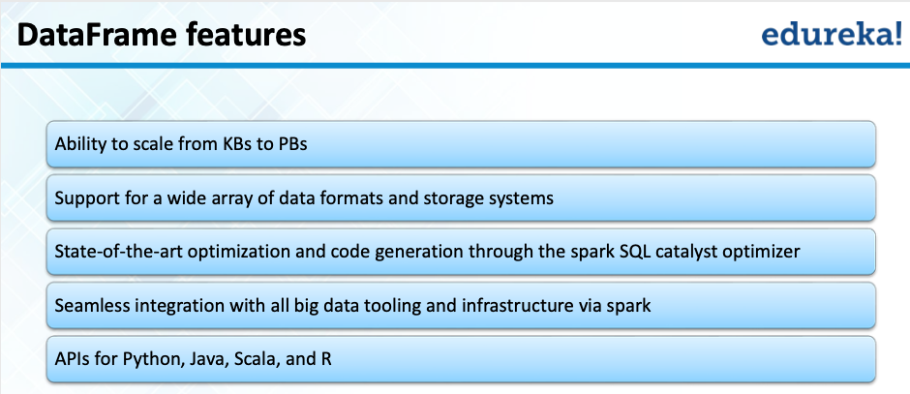
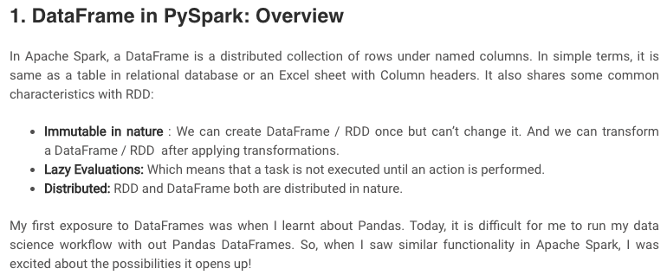
Spark/PySpark
https://www.analyticsvidhya.com/blog/2016/10/spark-dataframe-and-operations/

Slide 34
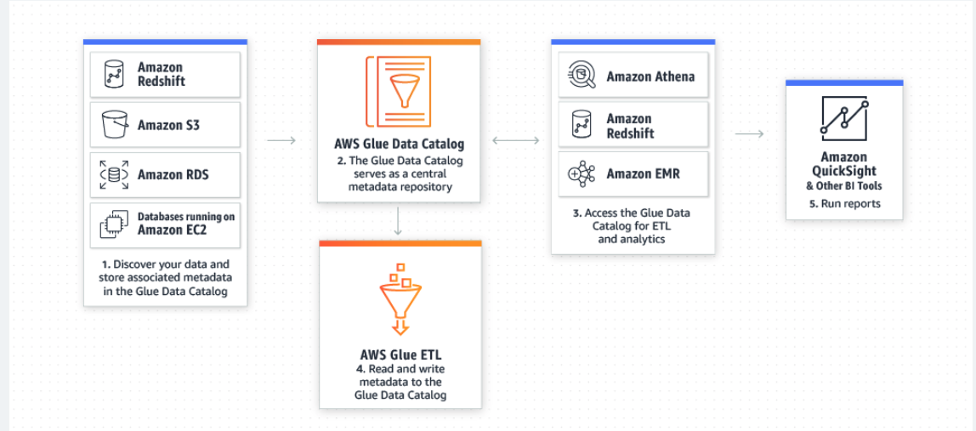
AWS Glue Supports Spark
AWS Glue is a serverless data preparation service that makes it easy for data engineers, extract, transform, and load (ETL) developers, data analysts, and data scientists to extract, clean, enrich, normalize, and load data.

Slide 35
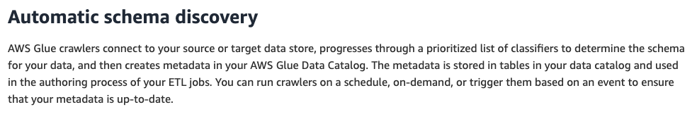
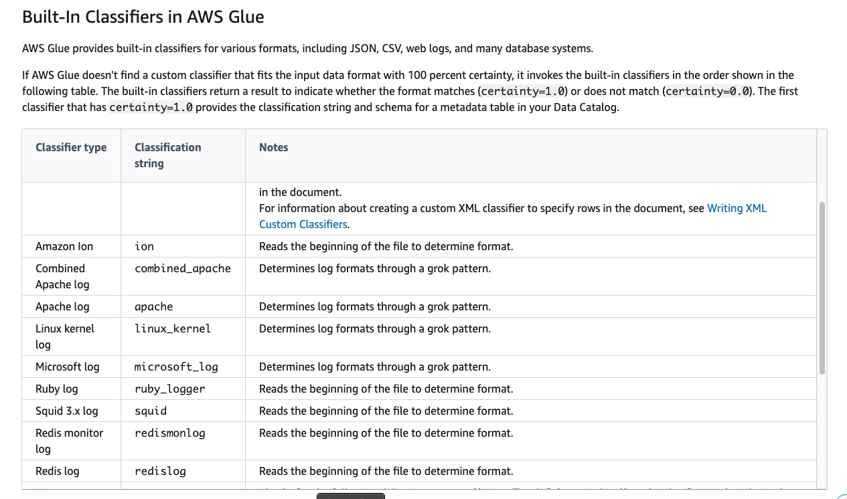
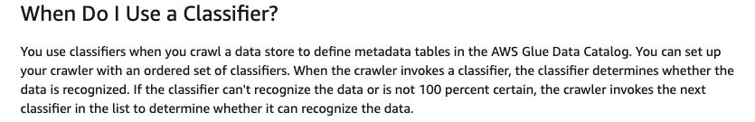
Crawlers/Classifiers

Slide 36
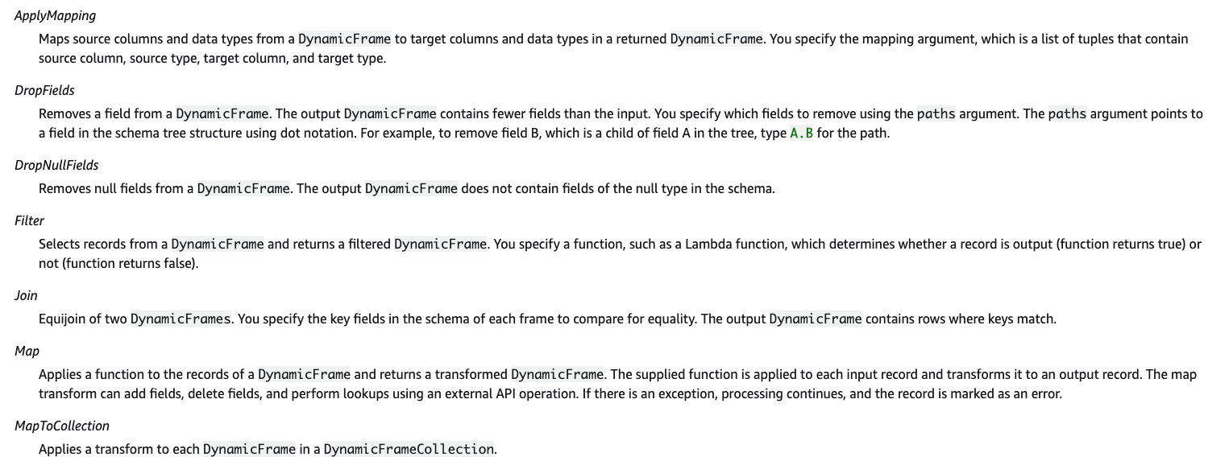
Built-In Transforms

Slide 37
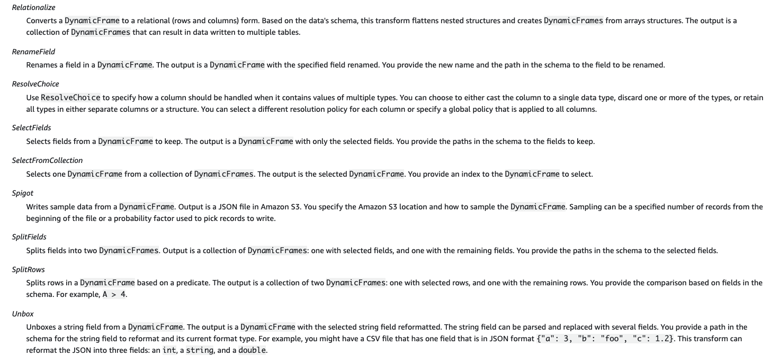
Built-In Transforms

Slide 38
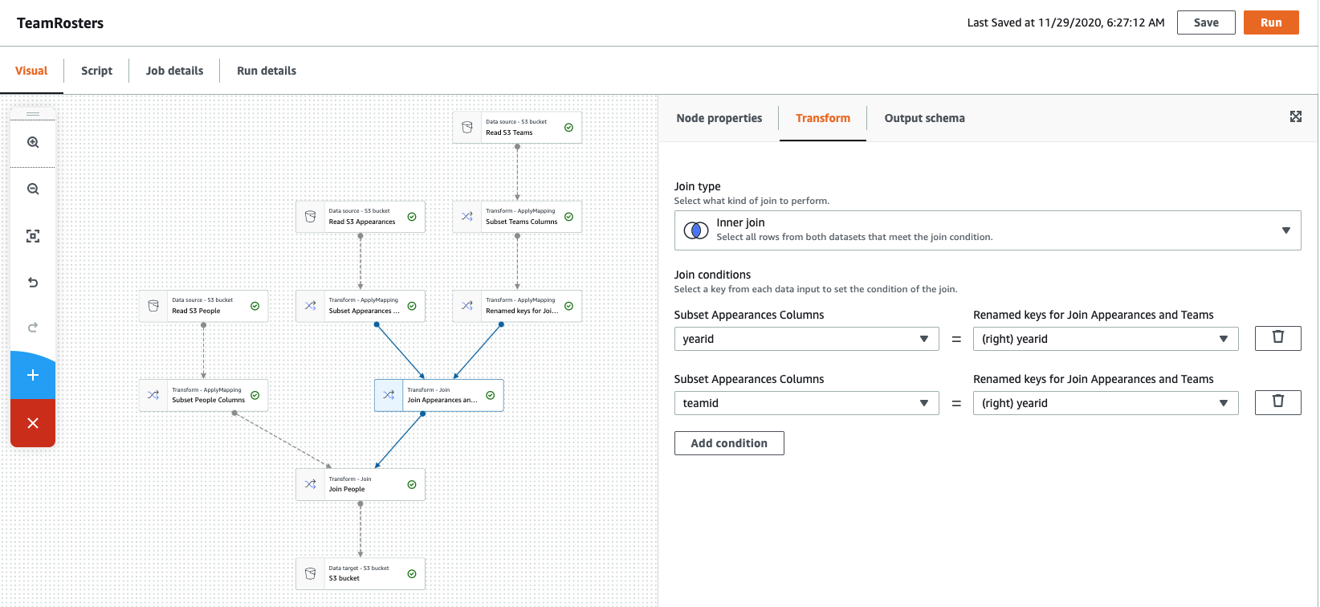
Visual Tools (There are similar tools for SQL, ETL, ... ...)

Slide 39
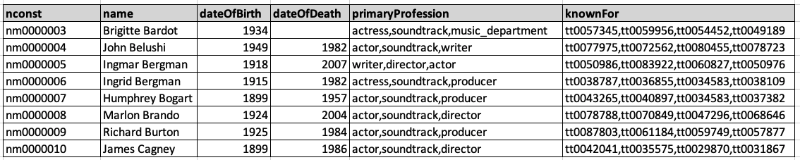
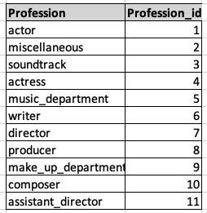
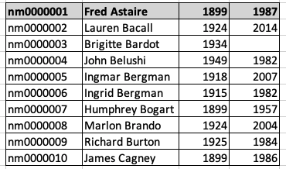
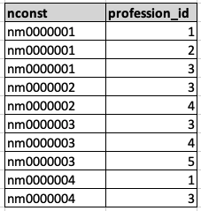
Conceptual Example
Consider the IMDB dataset. We should convert (other conversion needed)
To
You did some operators for this example in homework, and I did in class.

Slide 40
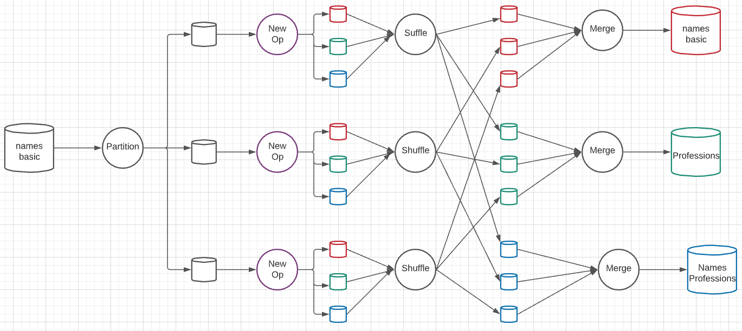
A New Algebraic Operator
Parallelism level is 3 simultaneous services at each stage.
Input is a dataset and column ID
Output is three datasets: dataset with column removed, table of distinct column values, associative entity.

Slide 41
Map Reduce vs. Databases
Map Reduce widely used for parallel processing
Google, Yahoo, and 100’s of other companies
Example uses: compute PageRank, build keyword indices, do data analysis of web click logs, ….
Allows procedural code in map and reduce functions
Allows data of any type
Many real-world uses of MapReduce cannot be expressed in SQL
But many computations are much easier to express in SQL
Map Reduce is cumbersome for writing simple queries

Slide 42
Map Reduce vs. Databases (Cont.)
Relational operations (select, project, join, aggregation, etc.) can be expressed using Map Reduce
SQL queries can be translated into Map Reduce infrastructure for execution
Apache Hive SQL, Apache Pig Latin, Microsoft SCOPE
Current generation execution engines support not only Map Reduce, but also other algebraic operations such as joins, aggregation, etc. natively.

Slide 43
Streaming Data

Slide 44
Streaming Data and Applications
Streaming data refers to data that arrives in a continuous fashion
Contrast to data-at-rest
Applications include:
Stock market: stream of trades
e-commerce site: purchases, searches
Sensors: sensor readings
Internet of things
Network monitoring data
Social media: tweets and posts can be viewed as a stream
Queries on streams can be very useful
Monitoring, alerts, automated triggering of actions

Slide 45
Querying Streaming Data
Approaches to querying streams:
Windowing: Break up stream into windows, and queries are run on windows
Stream query languages support window operations
Windows may be based on time or tuples
Must figure out when all tuples in a window have been seen
Easy if stream totally ordered by timestamp
Punctuations specify that all future tuples have timestamp greater that some value
Continuous Queries: Queries written e.g. in SQL, output partial results based on stream seen so far; query results updated continuously
Have some applications, but can lead to flood of updates

Slide 46
Querying Streaming Data (Cont.)
Approaches to querying streams (Cont.):
Algebraic operators on streams:
Each operator consumes tuples from a stream and outputs tuples
Operators can be written e.g., in an imperative language
Operator may maintain state
Pattern matching:
Queries specify patterns, system detects occurrences of patterns and triggers actions
Complex Event Processing (CEP) systems
E.g., Microsoft StreamInsight, Flink CEP, Oracle Event Processing

Slide 47
Stream Processing Architectures
Many stream processing systems are purely in-memory, and do not persist data
Lambda architecture: split stream into two, one output goes to stream processing system and the other to a database for storage
Easy to implement and widely used
But often leads to duplication of querying effort, once on streaming system and once in database

Slide 48
Stream Extensions to SQL
SQL Window functions described in Section 5.5.2
Streaming systems often support more window types
Tumbling window
E.g., hourly windows, windows don’t overlab
Hopping window
E.g., hourly window computed every 20 minutes
Sliding window
Window of specified size (based on timestamp interval or number of tuples) around each incoming tuple
Session window
Groups tuples based on user sessions

Slide 49
Window Syntax in SQL
Windowing syntax varies widely by system
E.g., in Azure Stream Analytics SQL:
select item, System.Timestamp as window end, sum(amount) from order timestamp by datetime group by itemid, tumblingwindow(hour, 1)
Aggregates are applied on windows
Result of windowing operation on a stream is a relation
Many systems support stream-relation joins
Stream-stream joins often require join conditions to specify bound on timestamp gap between matching tuples
E.g., tuples must be at most 30 minutes apart in timestamp

Slide 50
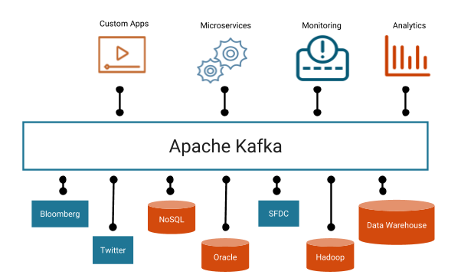
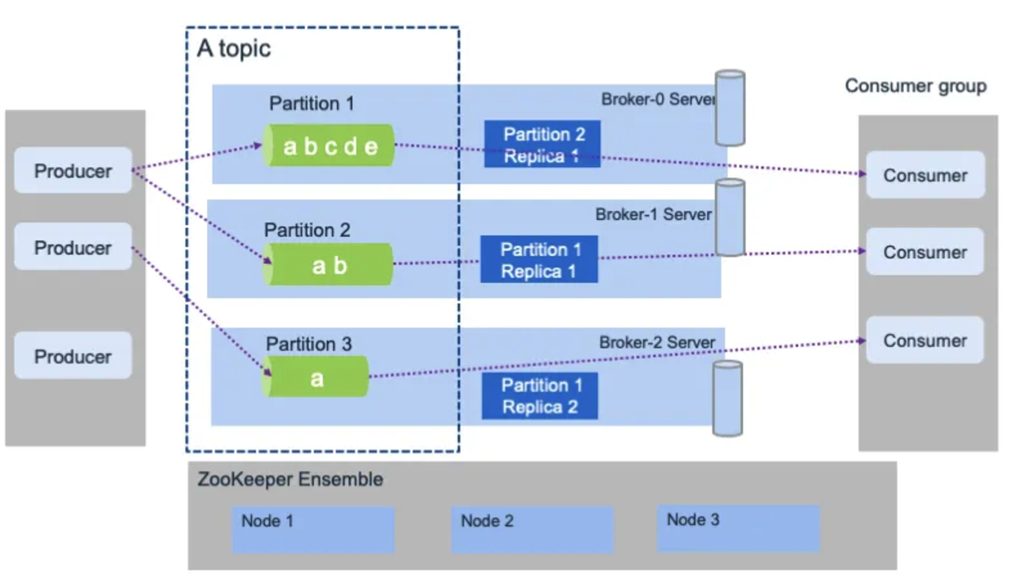
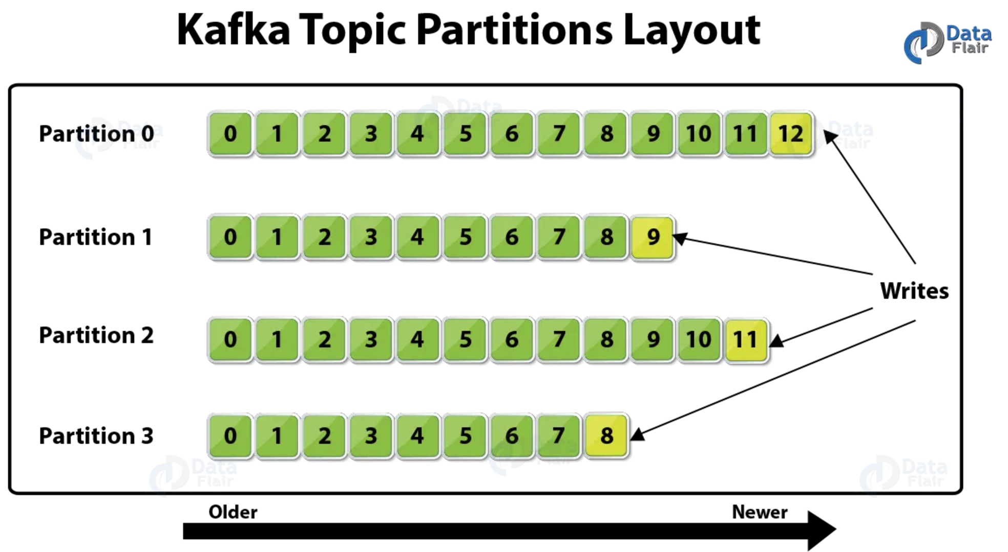
Stream Processing – Kafka Example
Kafka architecture has 4 actors:
Broker
Zookeeper
Producer
Consumer
There may be multiple brokers and multiple topics.
Topics are divided into partitions based on an event/ message key to enable parallelism.

Slide 51
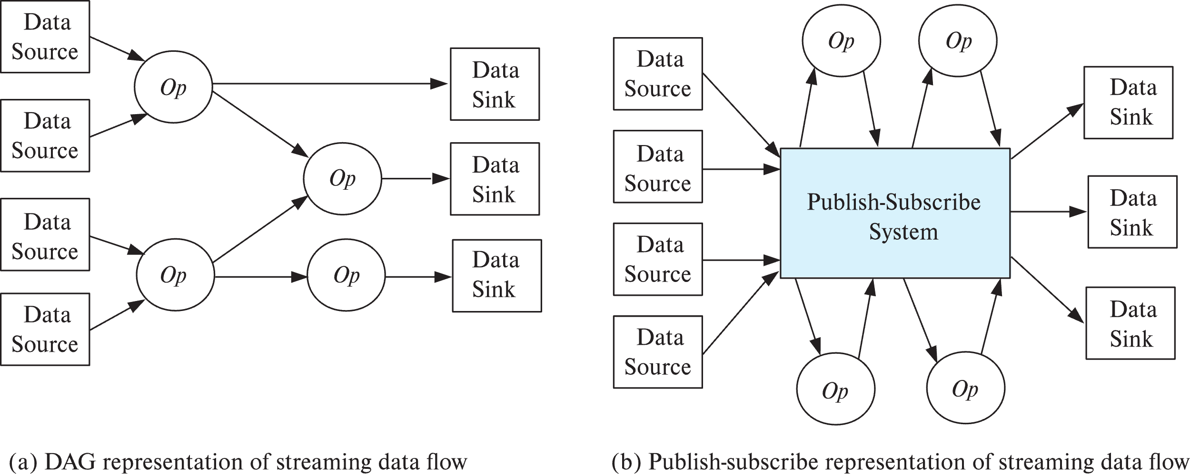
Algebraic Operations on Streams
Tuples in streams need to be routed to operators
Routing of streams using DAG and publish-subscribe representations
Used in Apache Storm and Apache Kafka respective

Slide 52
Publish Subscribe Systems
Publish-subscribe (pub-sub) systems provide convenient abstraction for processing streams
Tuples in a stream are published to a topic
Consumers subscribe to topic
Parallel pub-sub systems allow tuples in a topic to be partitioned across multiple machines
Apache Kafka is a popular parallel pub-sub system widely used to manage streaming data
More details in book

Slide 53
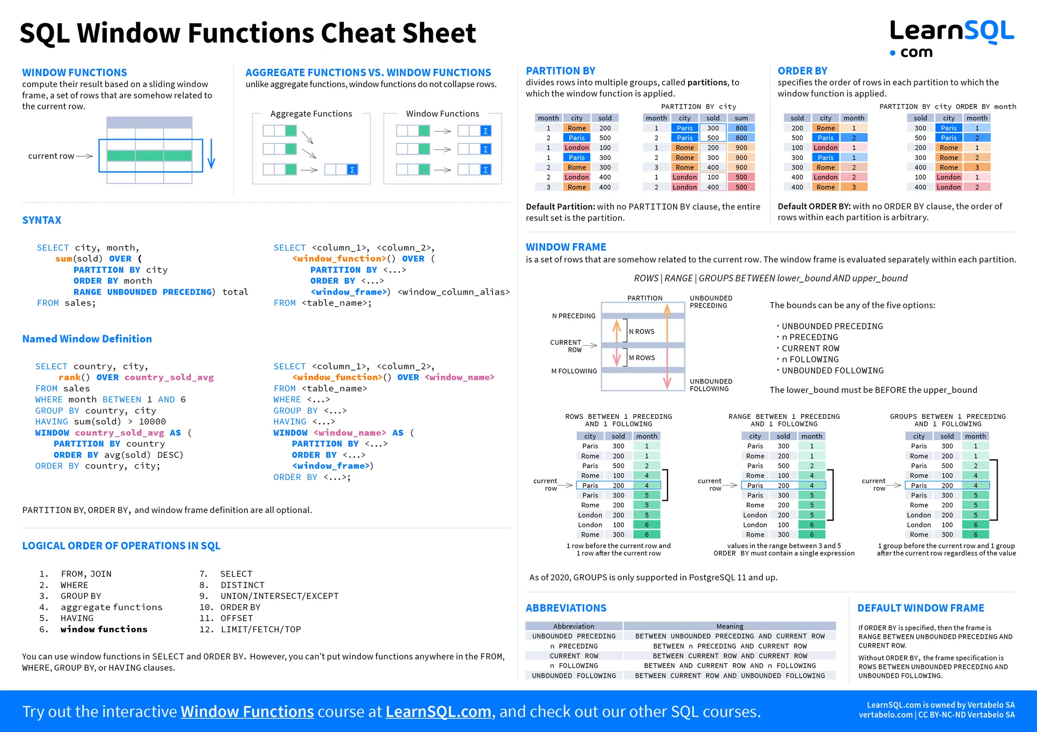
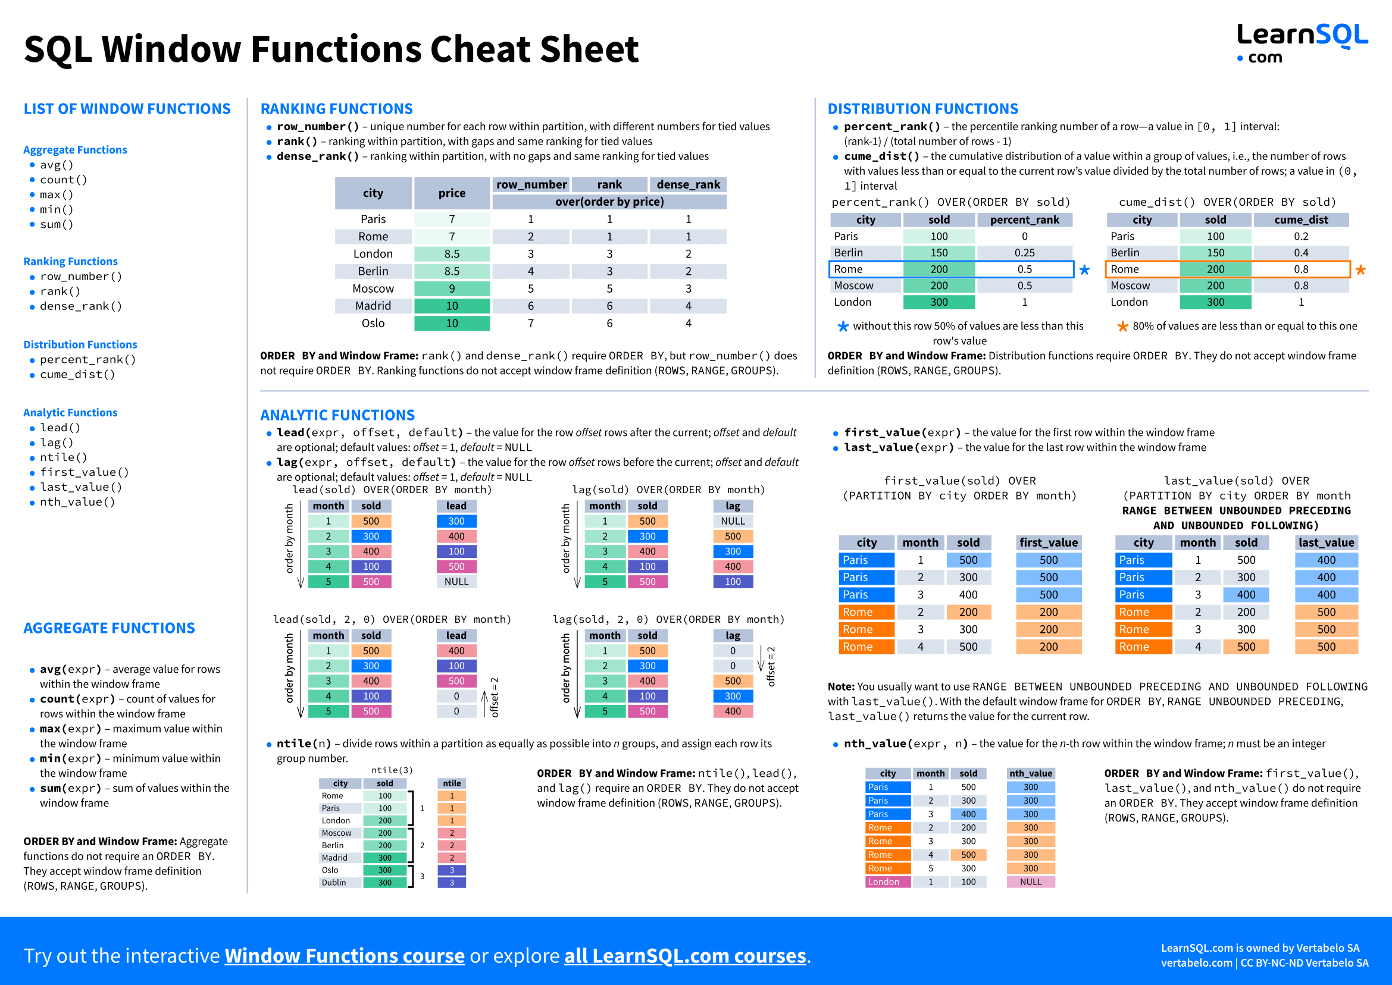
Window Functions in SQL
These are useful and powerful.
They will not be on the final, but you should be aware of them.
Similar queries and capabilities are extremely useful for stream processing.

Slide 54
Data Analysis and Insight

Slide 55
Data Analysis and OLAP
Online Analytical Processing (OLAP)
Interactive analysis of data, allowing data to be summarized and viewed in different ways in an online fashion (with negligible delay)
We use the following relation to illustrate OLAP concepts
sales (item_name, color, clothes_size, quantity)
This is a simplified version of the sales fact table joined with the dimension tables, and many attributes removed (and some renamed)

Slide 56
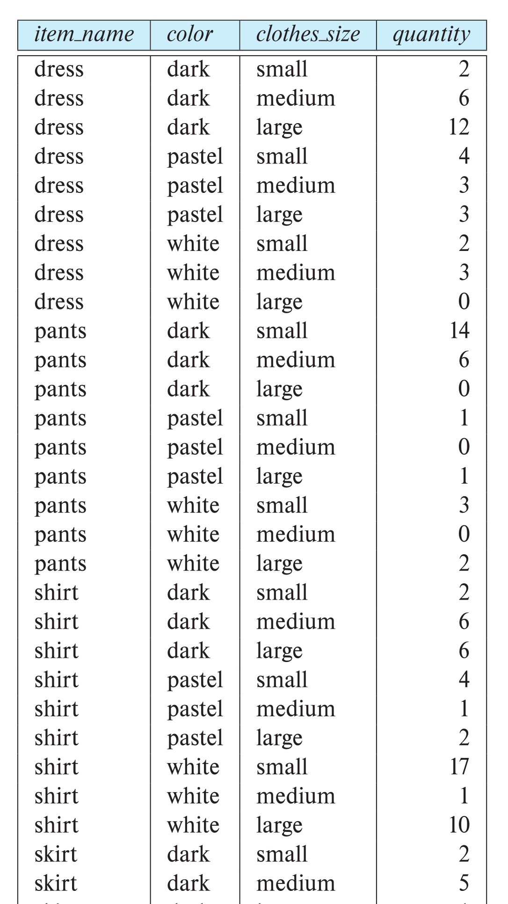
Example sales relation
...
...
...
...
...
...
...
...

Slide 57
Cross Tabulation of sales by item_name and color
The table above is an example of a cross-tabulation (cross-tab), also referred to as a pivot-table.
Values for one of the dimension attributes form the row headers
Values for another dimension attribute form the column headers
Other dimension attributes are listed on top
Values in individual cells are (aggregates of) the values of the dimension attributes that specify the cell.

Slide 58
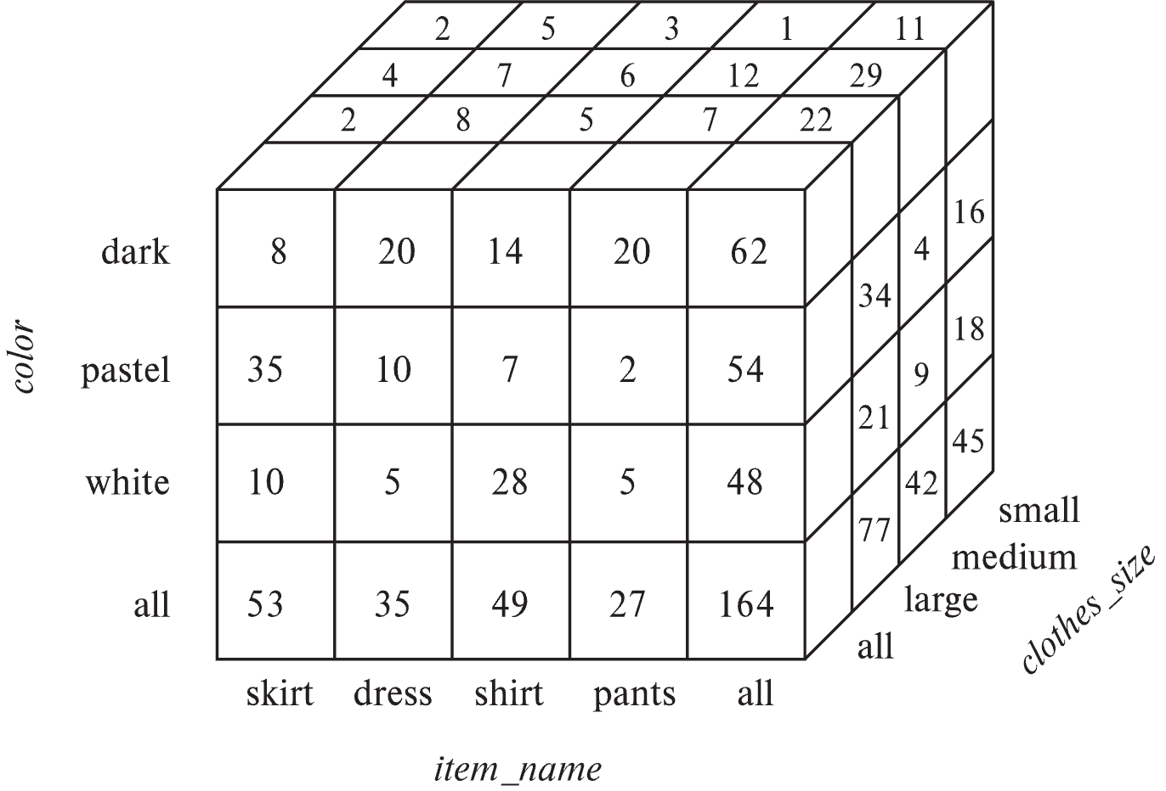
Data Cube
A data cube is a multidimensional generalization of a cross-tab
Can have n dimensions; we show 3 below
Cross-tabs can be used as views on a data cube

Slide 59
Online Analytical Processing Operations
Pivoting: changing the dimensions used in a cross-tab
E.g., moving colors to column names
Slicing: creating a cross-tab for fixed values only
E.g., fixing color to white and size to small
Sometimes called dicing, particularly when values for multiple dimensions are fixed.
Rollup: moving from finer-granularity data to a coarser granularity
E.g., aggregating away an attribute
E.g., moving from aggregates by day to aggregates by month or year
Drill down: The opposite operation - that of moving from coarser-granularity data to finer-granularity data

Slide 60
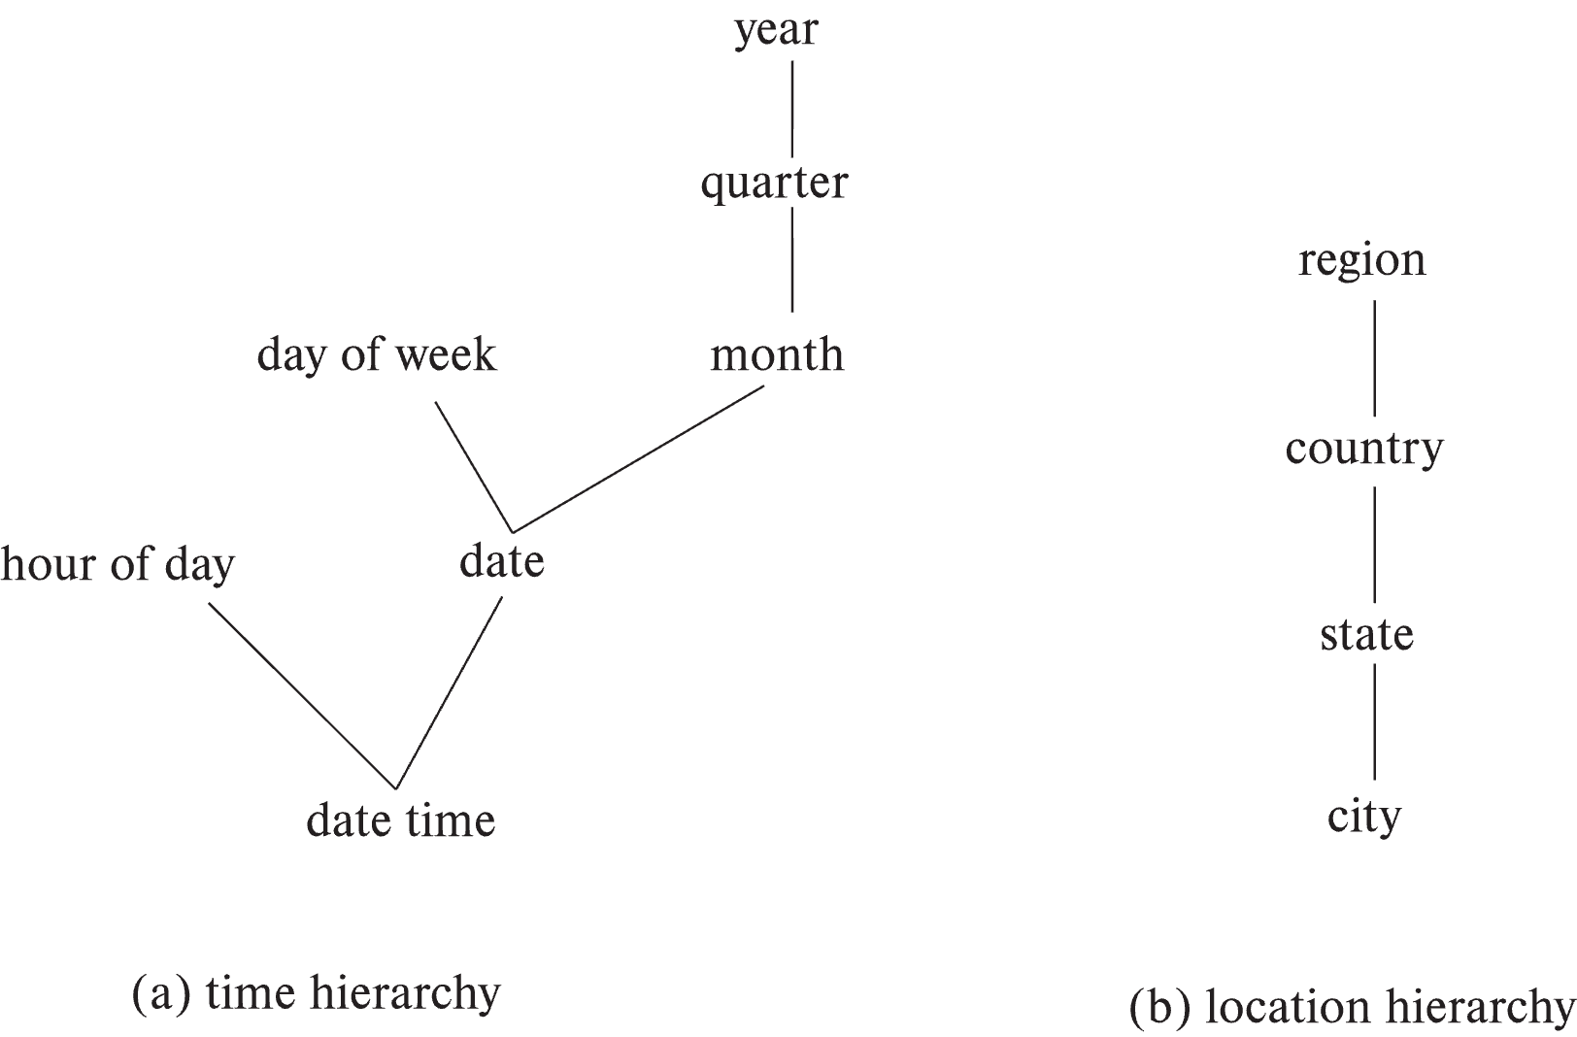
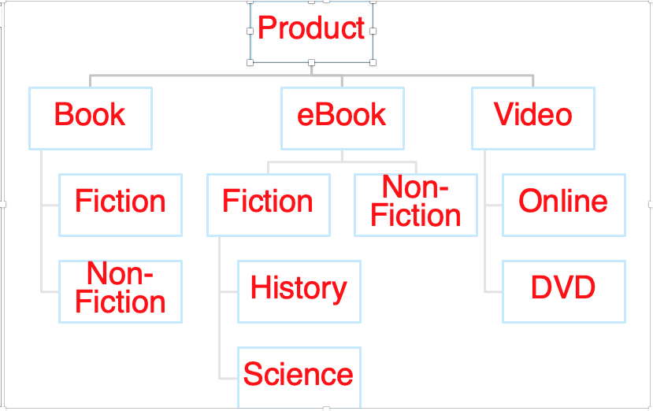
Hierarchies on Dimensions
Hierarchy on dimension attributes: lets dimensions be viewed at different levels of detail
E.g., the dimension datetime can be used to aggregate by hour of day, date, day of week, month, quarter or year
Another dimension could be ... Product category.

Slide 61
Another Dimension Example – Product Categories
Product
Book
eBook
Video
Fiction
Non-Fiction
Non-
Fiction
Fiction
Online
DVD
History
Science

Slide 62
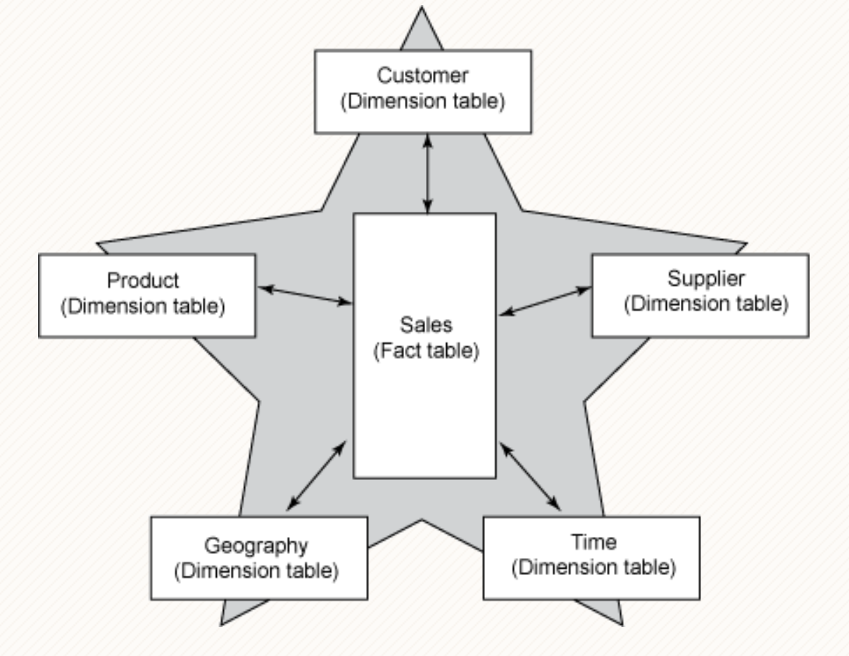
Facts and Dimensions

Slide 63
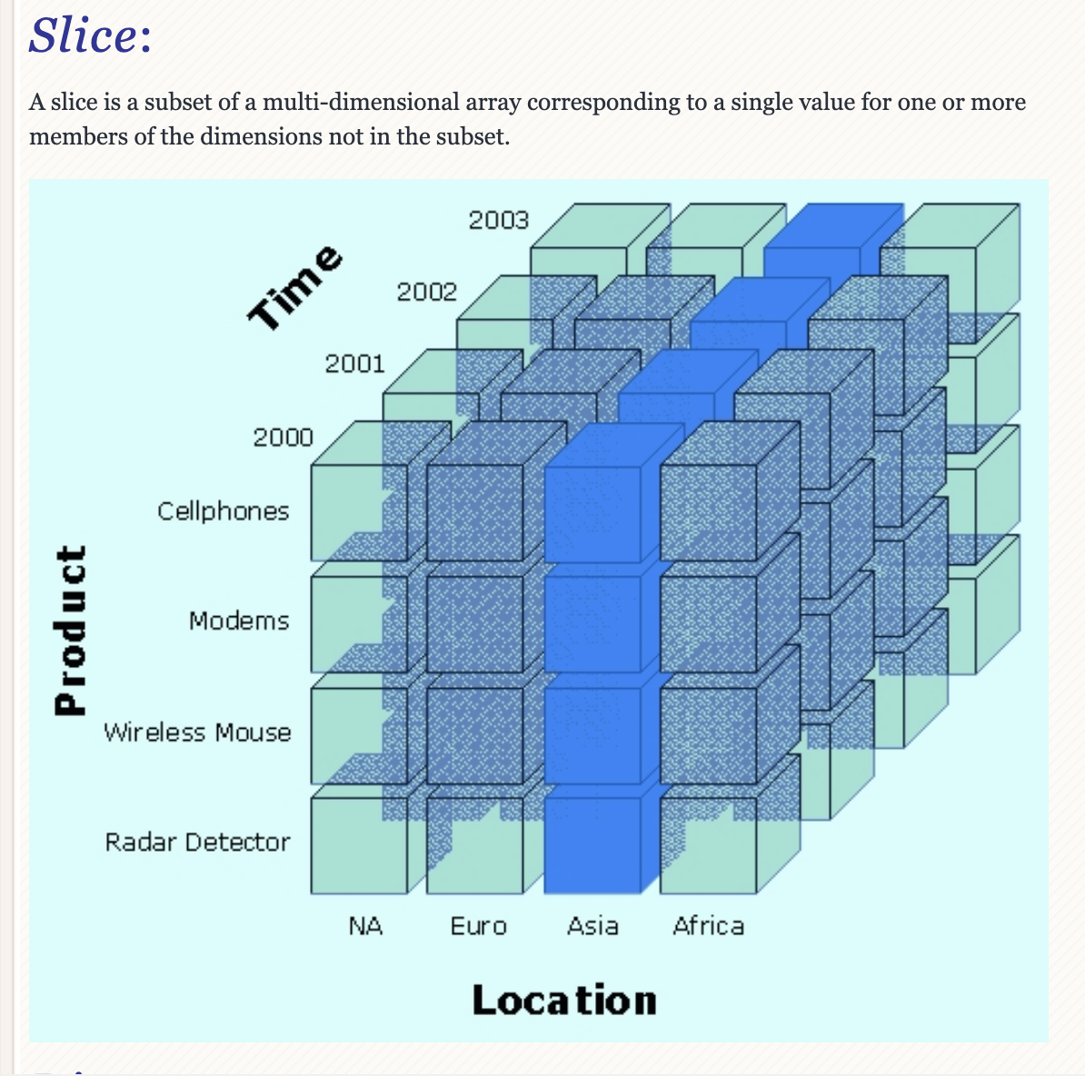
Slice

Slide 64
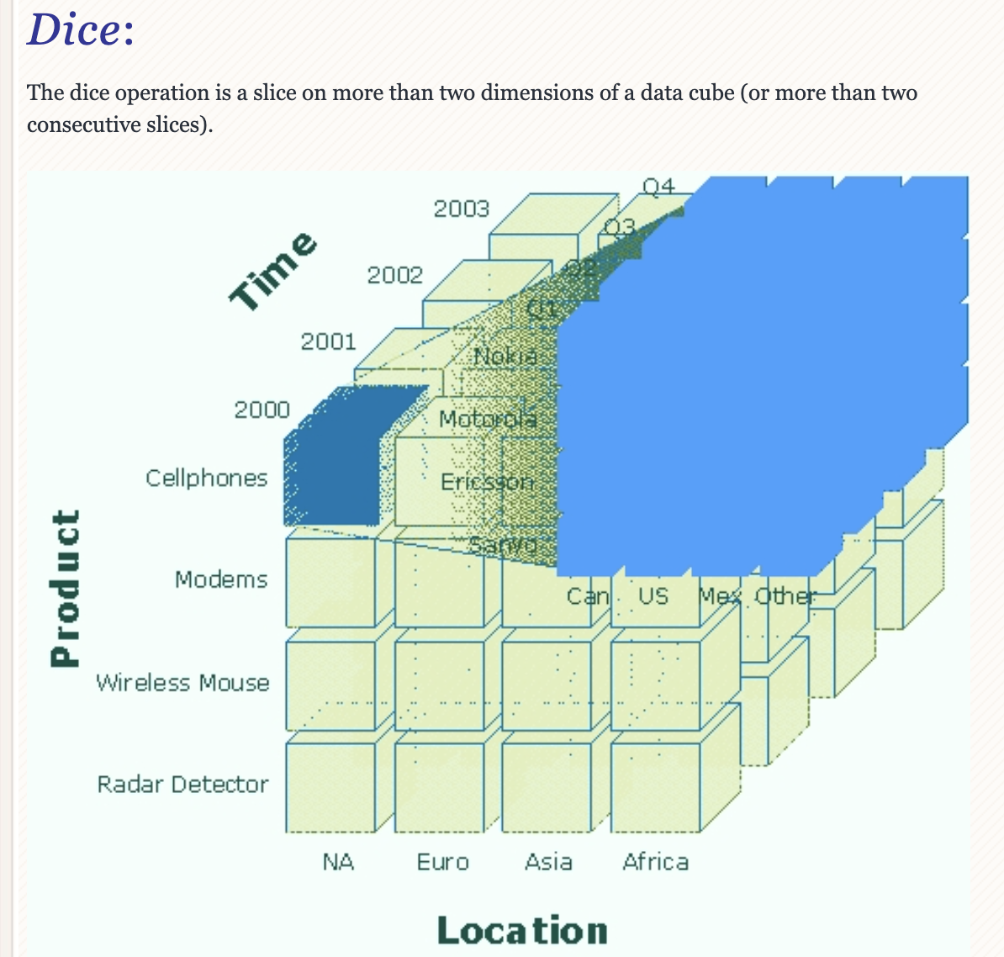
Dice

Slide 65
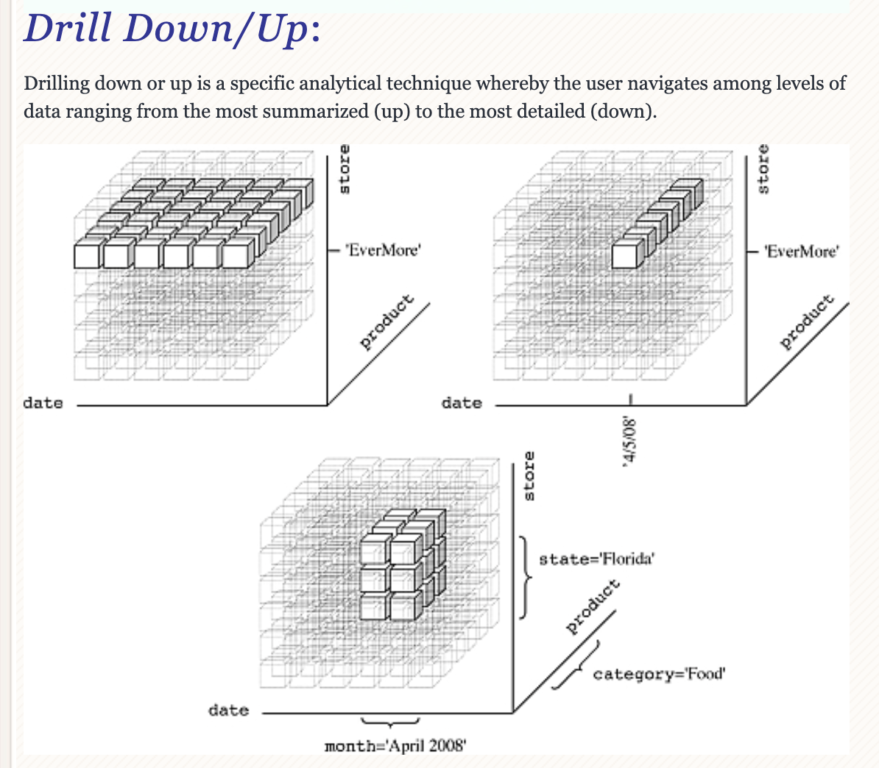
Drilling

Slide 66
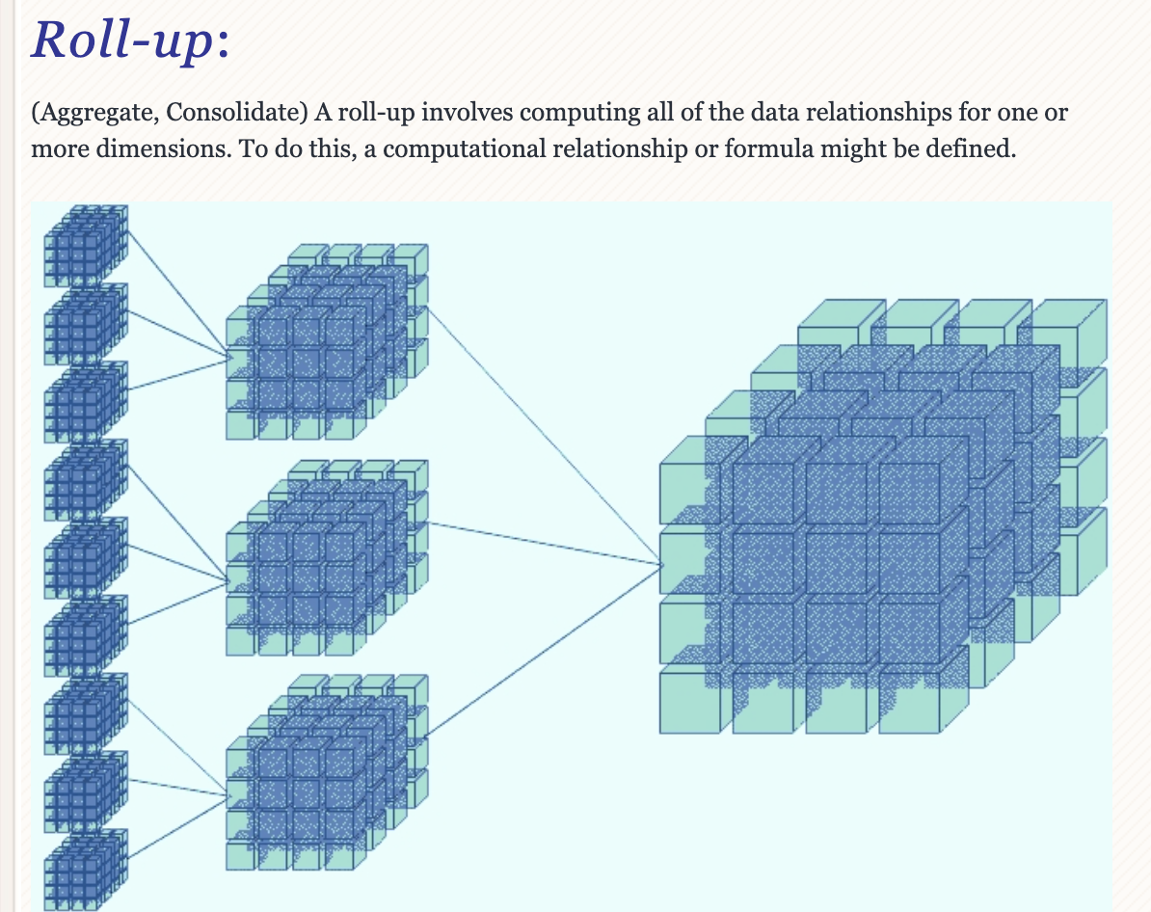
Roll-up

Slide 67
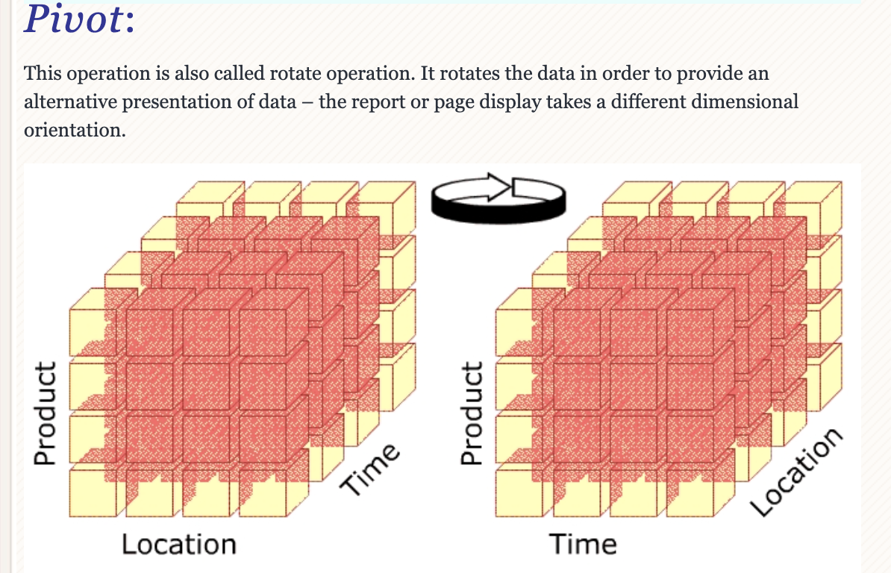
Pivot

Slide 68
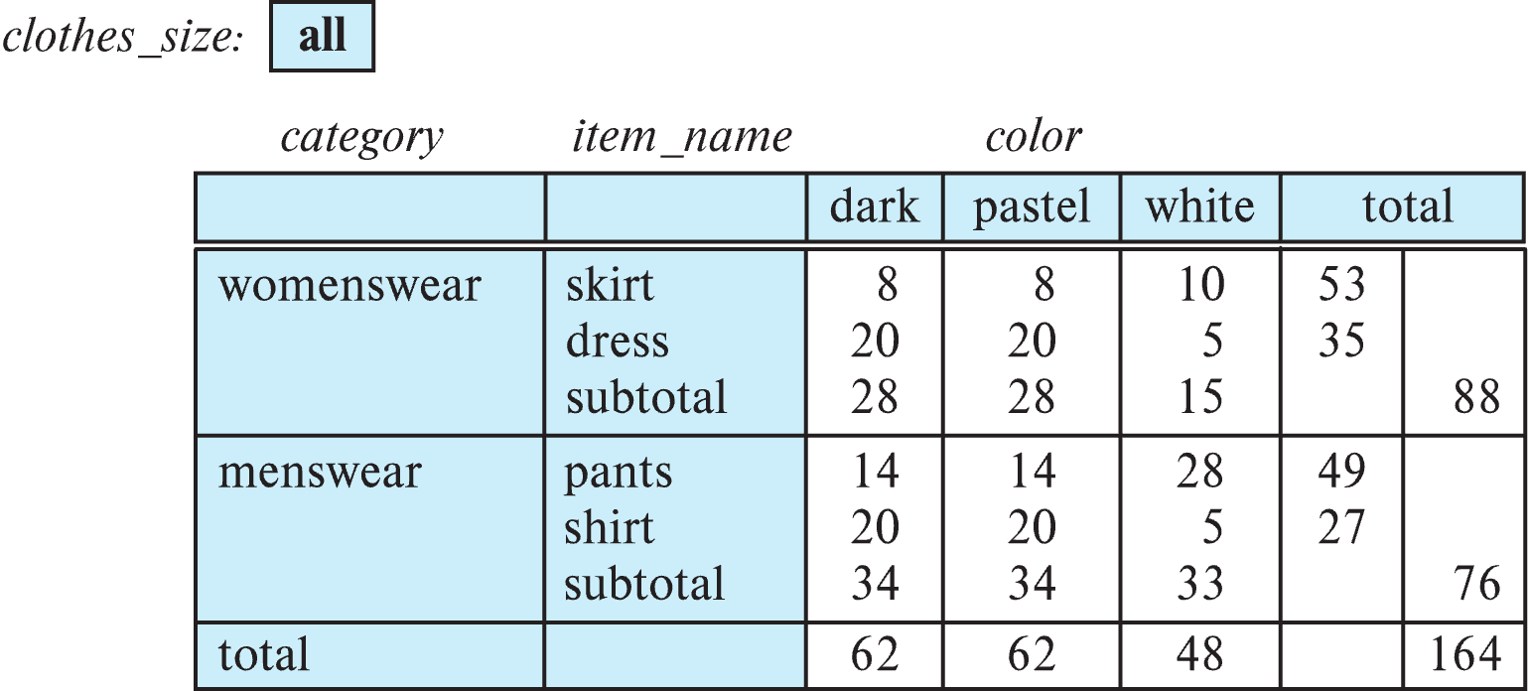
Cross Tabulation With Hierarchy
Cross-tabs can be easily extended to deal with hierarchies
Can drill down or roll up on a hierarchy
E.g. hierarchy: item_name → category

Slide 69
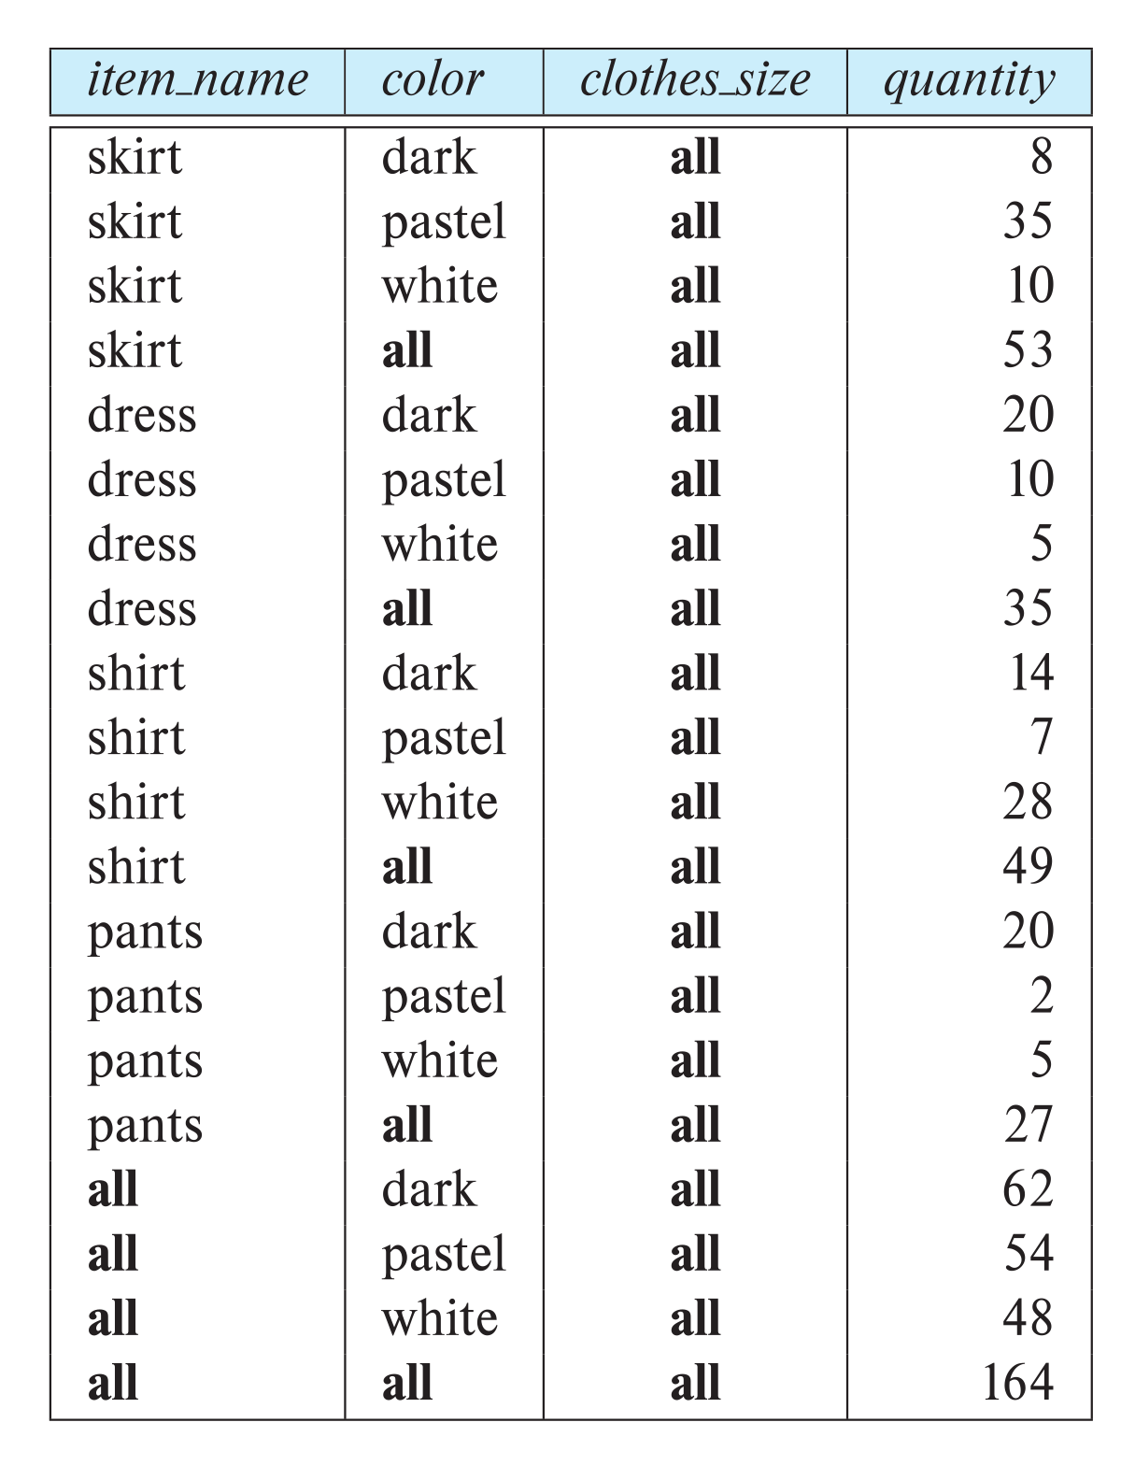
Relational Representation of Cross-tabs
Cross-tabs can be represented as relations
We use the value all to represent aggregates.
The SQL standard actually uses null values in place of all
Works with any data type
But can cause confusion with regular null values.

Slide 70
Data mining

Slide 71
Data Mining
Data mining is the process of semi-automatically analyzing large databases to find useful patterns
Similar goals to machine learning, but on very large volumes of data
Part of the larger area of knowledge discovery in databases (KDD)
Some types of knowledge can be represented as rules
More generally, knowledge is discovered by applying machine learning techniques on past instances of data, to form a model
Model is then used to make predictions for new instances

Slide 72
Types of Data Mining Tasks
Prediction based on past history
Predict if a credit card applicant poses a good credit risk, based on some attributes (income, job type, age, ..) and past history
Predict if a pattern of phone calling card usage is likely to be fraudulent
Some examples of prediction mechanisms:
Classification
Items (with associated attributes) belong to one of several classes
Training instances have attribute values and classes provided
Given a new item whose class is unknown, predict to which class it belongs based on its attribute values
Regression formulae
Given a set of mappings for an unknown function, predict the function result for a new parameter value

Slide 73
Data Mining (Cont.)
Descriptive Patterns
Associations
Find books that are often bought by “similar” customers. If a new such customer buys one such book, suggest the others too.
Associations may be used as a first step in detecting causation
E.g., association between exposure to chemical X and cancer,
Clusters
E.g., typhoid cases were clustered in an area surrounding a contaminated well
Detection of clusters remains important in detecting epidemics

Slide 74
Classification Rules
Classification rules help assign new objects to classes.
E.g., given a new automobile insurance applicant, should he or she be classified as low risk, medium risk or high risk?
Classification rules for above example could use a variety of data, such as educational level, salary, age, etc.
∀ person P, P.degree = masters and P.income > 75,000
⇒ P.credit = excellent
∀ person P, P.degree = bachelors and (P.income ≥ 25,000 and P.income ≤ 75,000) ⇒ P.credit = good
Rules are not necessarily exact: there may be some misclassifications
Classification rules can be shown compactly as a decision tree.

Slide 75
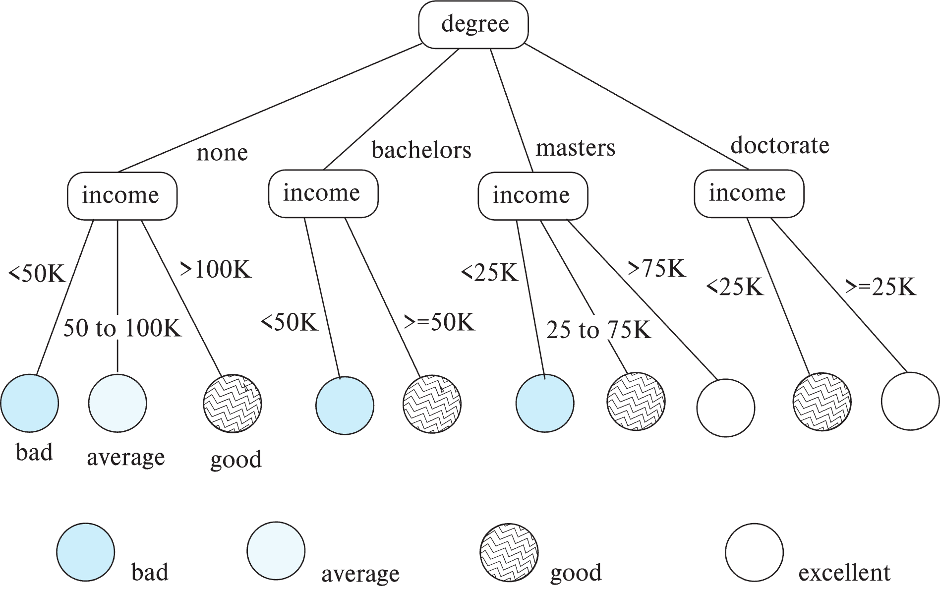
Decision Tree Classifiers

Slide 76
Decision Trees
Each internal node of the tree partitions the data into groups based on a partitioning attribute, and a partitioning condition for the node
Leaf node:
all (or most) of the items at the node belong to the same class, or
all attributes have been considered, and no further partitioning is possible.
Traverse tree from top to make a prediction
Number of techniques for constructing decision tree classifiers
We omit details

Slide 77
Bayesian Classifiers
Bayesian classifiers use Bayes theorem, which says
p (c_{j} | d ) = p (d | c_{j} ) p(c_{j} )
p (d) where p (c_{j} | d) = probability of instance d being in class c_{j},
p (d | c_{j} ) = probability of generating instance d given class c_{j},
p (c_{j} ) = probability of occurrence of class c_{j}, and
p (d) = probability of instance d occuring

Slide 78
Naïve Bayesian Classifiers
Bayesian classifiers require
computation of p (d | c_{j} )
precomputation of p (c_{j} )
p (d) can be ignored since it is the same for all classes
To simplify the task, naïve Bayesian classifiers assume attributes have independent distributions, and thereby estimate
p (d | c_{j}) = p (d₁ | c_{j} ) * p (d₂ | c_{j} ) * ….* (p (d_{n} | c_{j} )
Each of the p (d_{i} | c_{j} ) can be estimated from a histogram on d_{i} values for each class c_{j}
the histogram is computed from the training instances
Histograms on multiple attributes are more expensive to compute and store

Slide 79
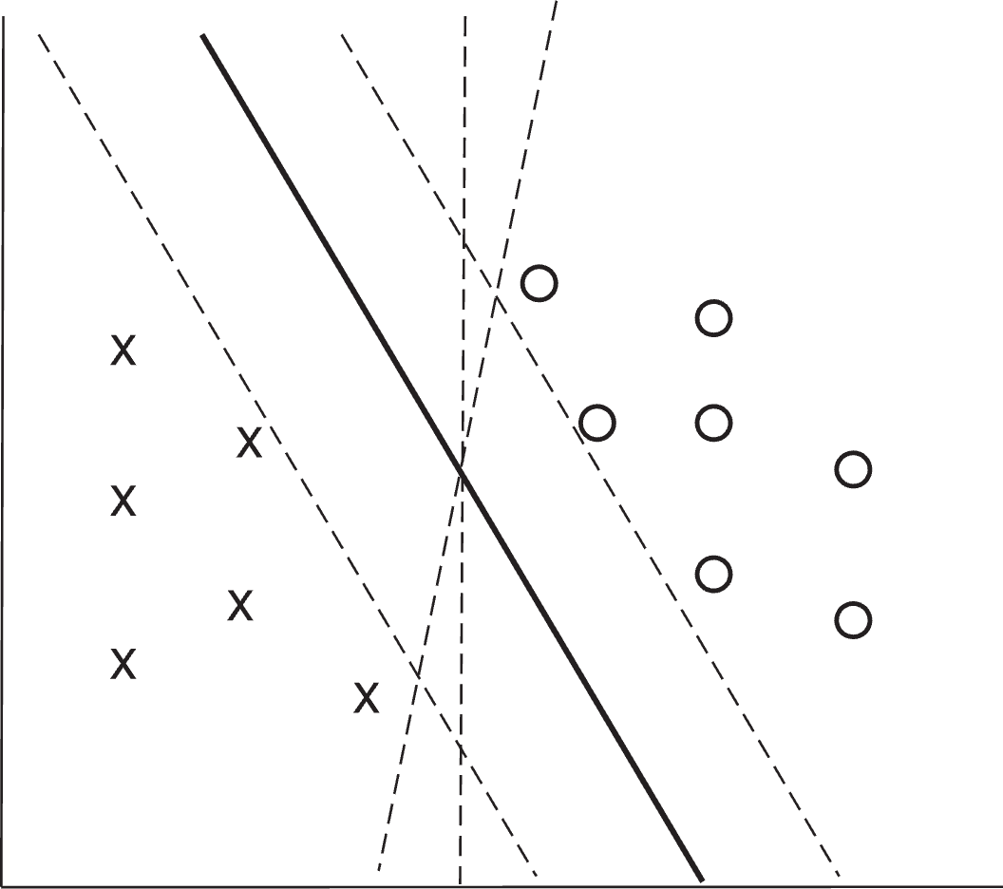
Support Vector Machine Classifiers
Simple 2-dimensional example:
Points are in two classes
Find a line (maximum margin line) s.t. line divides two classes, and distance from nearest point in either class is maximum

Slide 80
Support Vector Machine
In n-dimensions points are divided by a plane, instead of a line
SVMs can be used separators that are curve, not necessarily linear, by transforming points before classification
Transformation functions may be non-linear and are called kernel functions
Separator is a plane in the transformed space, but maps to curve in original space
There may not be an exact planar separator for a given set of points
Choose plane that best separates points
N-ary classification can be done by N binary classifications
In class i vs. not in class i.

Slide 81
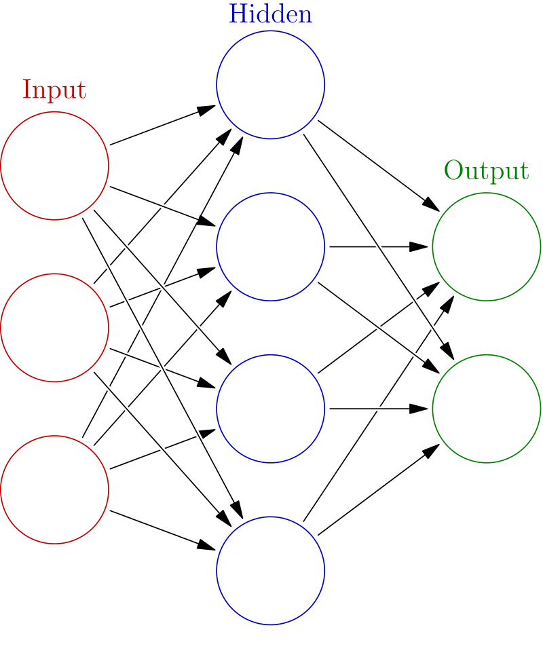
Neural Network Classifiers
Neural network has multiple layers
Each layer acts as input to next later
First layer has input nodes, which are assigned values from input attributes
Each node combines values of its inputs using some weight function to compute its value
Weights are associated with edges
For classification, each output value indicates likelihood of the input instance belonging to that class
Pick class with maximum likelihood
Weights of edges are key to classification
Edge weights are learnt during training phase

Slide 82

Neural Network Classifiers
Value of a node may be linear combination of inputs, or may be a non-linear function
E.g., sigmoid function
Backpropagation algorithm works as follows
Weights are set randomly initially
Training instances are processed one at a time
Output is computed using current weights
If classification is wrong, weights are tweaked to get a higher score for the correct class

Slide 83
Neural Networks (Cont.)
Deep neural networks have a large number of layers with large number of nodes in each layer
Deep learning refers to training of deep neural network on very large numbers of training instances
Each layer may be connected to previous layers in different ways
Convolutional networks used for image processing
More complex architectures used for text processing, and machine translation, speech recognition, etc.
Neural networks are a large area in themselves
Further details beyond scope of this chapter

Slide 84
Regression
Regression deals with the prediction of a value, rather than a class.
Given values for a set of variables, X₁, X₂, …, X_{n}, we wish to predict the value of a variable Y.
One way is to infer coefficients a₀, a₁, a₁, …, a_{n} such that Y = a₀ + a₁ * X₁ + a₂ * X₂ + … + a_{n} * X_{n}
Finding such a linear polynomial is called linear regression.
In general, the process of finding a curve that fits the data is also called curve fitting.
The fit may only be approximate
because of noise in the data, or
because the relationship is not exactly a polynomial
Regression aims to find coefficients that give the best possible fit.

Slide 85
Association Rules
Retail shops are often interested in associations between different items that people buy.
Someone who buys bread is quite likely also to buy milk
A person who bought the book Database System Concepts is quite likely also to buy the book Operating System Concepts.
Associations information can be used in several ways.
E.g. when a customer buys a particular book, an online shop may suggest associated books.
Association rules:
bread ⇒ milk DB-Concepts, OS-Concepts ⇒ Networks
Left hand side: antecedent, right hand side: consequent
An association rule must have an associated population; the population consists of a set of instances
E.g. each transaction (sale) at a shop is an instance, and the set of all transactions is the population

Slide 86
Association Rules (Cont.)
Rules have an associated support, as well as an associated confidence.
Support is a measure of what fraction of the population satisfies both the antecedent and the consequent of the rule.
E.g., suppose only 0.001 percent of all purchases include milk and screwdrivers. The support for the rule is milk ⇒ screwdrivers is low.
Confidence is a measure of how often the consequent is true when the antecedent is true.
E.g., the rule bread ⇒ milk has a confidence of 80 percent if 80 percent of the purchases that include bread also include milk.
We omit further details, such as how to efficiently infer association rules

Slide 87
Clustering
Clustering: Intuitively, finding clusters of points in the given data such that similar points lie in the same cluster
Can be formalized using distance metrics in several ways
Group points into k sets (for a given k) such that the average distance of points from the centroid of their assigned group is minimized
Centroid: point defined by taking average of coordinates in each dimension.
Another metric: minimize average distance between every pair of points in a cluster
Hierarchical clustering: example from biological classification
(the word classification here does not mean a prediction mechanism)
chordata mammalia reptilia
leopards humans snakes crocodiles

Slide 88
Clustering and Collaborative Filtering
Goal: predict what movies/books/… a person may be interested in, on the basis of
Past preferences of the person
Preferences of other people
One approach based on repeated clustering
Cluster people based on their preferences for movies
Then cluster movies on the basis of being liked by the same clusters of people
Again cluster people based on their preferences for (the newly created clusters of) movies
Repeat above till equilibrium
Given new user
Find most similar cluster of existing users and
Predict movies in movie clusters popular with that user cluster
Above problem is an instance of collaborative filtering

Slide 89
Other Types of Mining
Text mining: application of data mining to textual documents
Sentiment analysis
E.g., learn to predict if a user review is positive or negative about a product
Information extraction
Create structured information from unstructured textual description or semi-structured data such as tabular displays
Entity recognition and disambiguation
E.g., given text with name “Michael Jordan” does the name refer to the famous basketball player or the famous ML expert
Knowledge graph (see Section 8.4)
Can be constructed by information extraction from different sources, such as Wikipedia

Slide 90
Some Examples
Lecture Notebook HW 3B
HW 4B Non-Programming

